Slide 1
Credit Card churn prediction
Quoc Frejter 430201, Katarzyna Dybcio 430189

Slide 2
Problem description
Background
The business manager, that is taking care of consumer credit card portfolio, is concerned about the increasing number of customers leaving their credit card services.
Problem
With only 16.07% of customers exhibiting churn, predicting churn is challenging due to class imbalance.
Aim of the project
Develop a predictive model to identify potential churners, empowering the bank to proactively engage and retain customers through personalized services.

Slide 3

Dataset
Target Variable: Attrition_customer
Internal event (customer activity) variable - if the account is closed then 1 else 0
Independent Variables: 20 features
'CLIENTNUM', 'Attrition_Flag', 'Customer_Age', 'Gender', 'Dependent_count', 'Education_Level', 'Marital_Status', 'Income_Category', 'Card_Category', 'Months_on_book', 'Total_Relationship_Count', 'Months_Inactive_12_mon', 'Contacts_Count_12_mon', 'Credit_Limit', 'Total_Revolving_Bal', 'Avg_Open_To_Buy', 'Total_Amt_Chng_Q4_Q1', 'Total_Trans_Amt', 'Total_Trans_Ct', 'Total_Ct_Chng_Q4_Q1', 'Avg_Utilization_Ratio'
10127 observations
Notes:
Kate

Slide 4
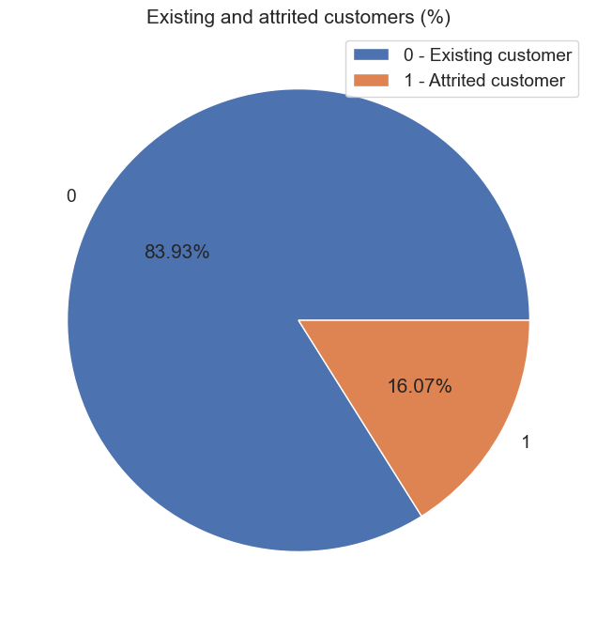
Target Variable
Highly imbalanced dataset
Attrition_Flag | Count | Percent of all
0 | 8500 | 84%
1 | 1627 | 16%
Notes:
Kate

Slide 5
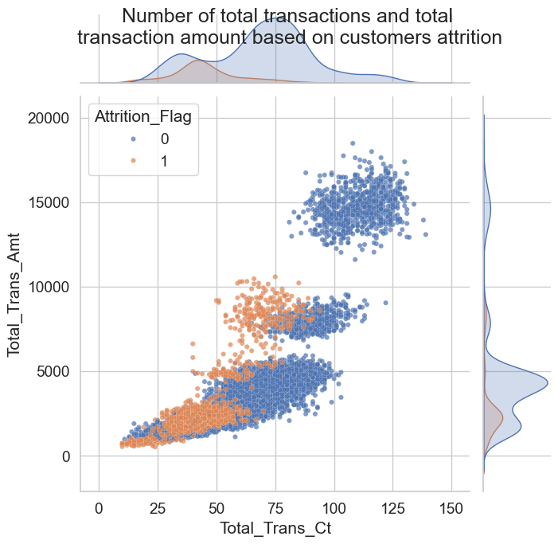
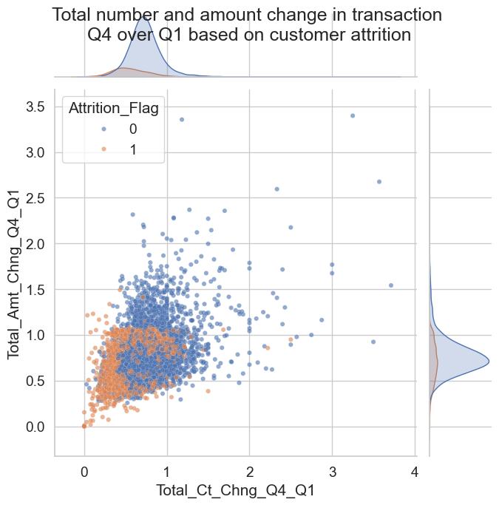
Customers who have opted out of the bank's services have significantly fewer completed transactions, and these transactions involve a lower average amount of funds.
Notes:
Kate

Slide 6
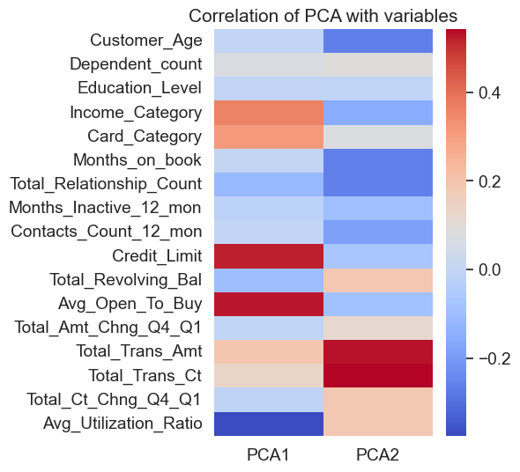
K-means, PCA - clustering of customers
High PCA1
High income, "premium" card, high credit limit but low utilization
Wealthy customers who exhibit a low utilization ratio.
High PCA2
Young, low income, low number of month on book, low number of products, high transaction count and amount
Young/new customers who actively use their cards
Notes:
An

Slide 7
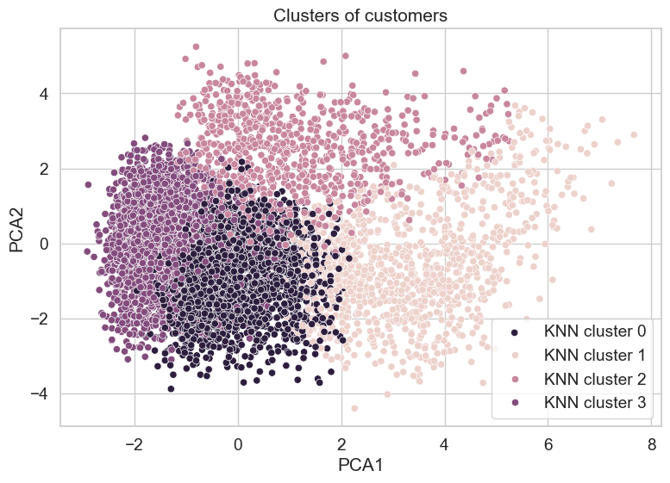
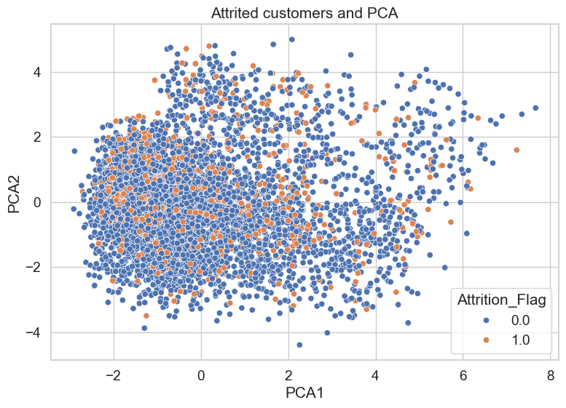
Plot of clusters
On this plot we can see, that employing K-Nearest Neighbors (KNN) and Principal Component Analysis (PCA) for modeling the attrition flag could pose challenges. We can see that customers are quite mixed up and our algorithm would have problems dividing the group.
Notes:
An

Slide 8
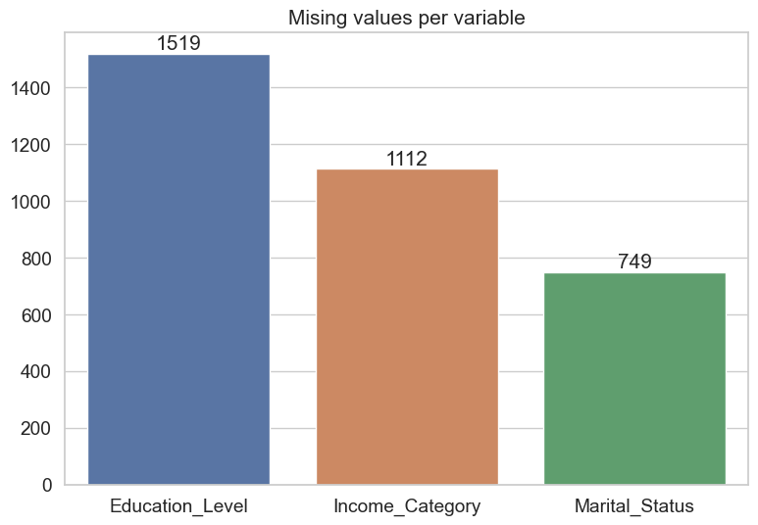
Missing values
We have missing values only for Education level, Marital status and income category
Imputation methods
Education_level - imputed using KNN
Income_category - imputed using KNN
Marital_Status - Filled missing values with most frequent
Notes:
Kate

Slide 9
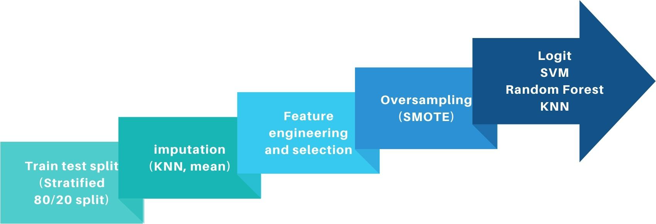

Steps for success
Notes:
Kate

Slide 10
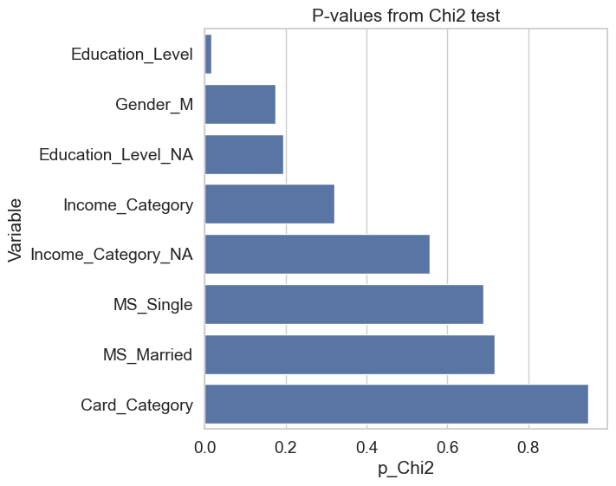
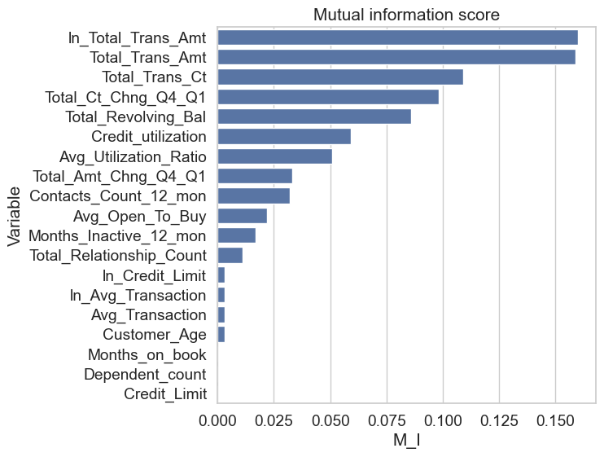
Feature engineering and selection
Transformations:
Categorical variables: one-hot encoding, ordinal encoder
Numerical variables: log transformation, standard scaler
Interactions: average transaction, account utilization
Notes:
An

Slide 11

Hyperparameter tuning
Method: Grid search
Cross validation: Stratified K-fold (8 splits)
Scoring measures:
F1 score
Matthews correlation coefficient
ROC AUC (additional)
Notes:
An

Slide 12
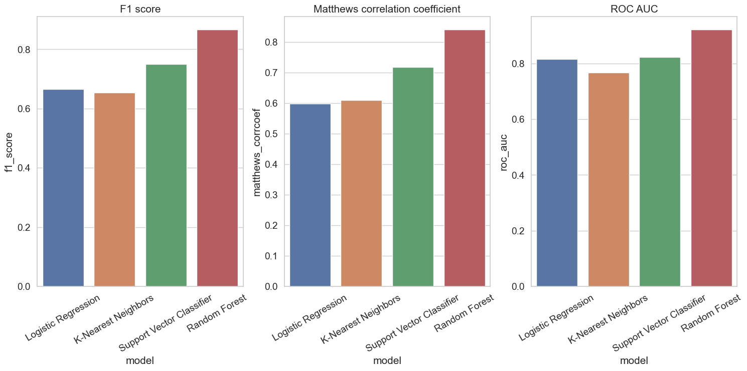
Models performance
Notes:
An

Slide 13
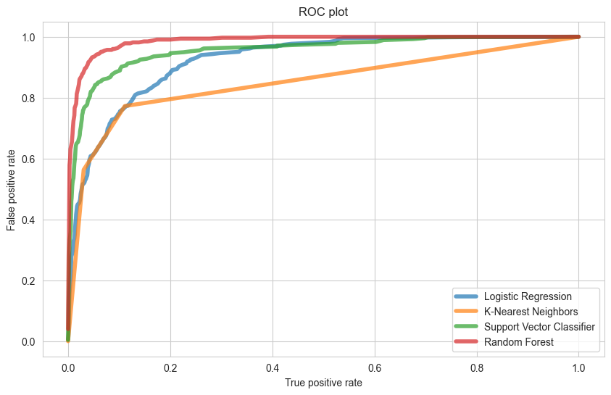
Models performance
Notes:
An

Slide 14
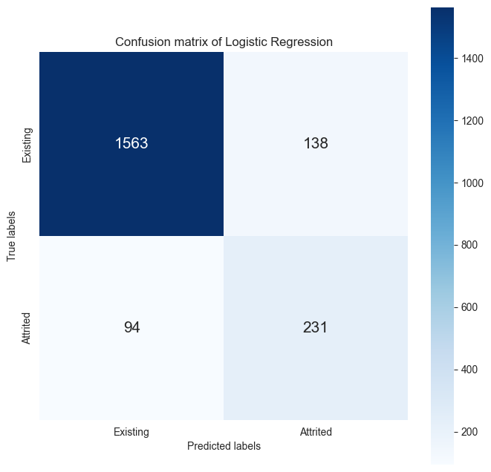

Logistic Regression vs Random Forest
Notes:
Kate

Slide 15
Summary
Additionally, Random Forest correctly identified the highest number of customers(238) who actually churned from the bank services
In almost every model, the best results were achieved with data augmented using the SMOTE method. That is because our data was highly imbalanced.
For the Random Forest, it was beneficial to reduce the number of variables when training the model what was confirmed by the test statistics.
Based on this, we can conclude that the Random Forest model is the most effective method for our database.
Notes:
kate

Slide 16
Thank you!

